Slide 1

The Battle of the Neighborhoods
2020 coronavirus pandemic in the US
Coursera
Minh Cong Tran
April 27th, 2020

Slide 2





Agenda
Introduction: Problem, Target Audiences
Data
Method
Results & Discussion
Conclusion

Slide 3
Introduction
Problem
The ongoing pandemic of coronavirus disease 2019 (COVID-19), a novel infectious disease caused by severe acute respiratory syndrome coronavirus 2 (SARS-CoV-2), spread to the United States in January 2020. The widespread disease transmission may force large numbers of people to seek healthcare, which could overload healthcare systems and lead to otherwise preventable deaths.
Target Audiences
The target audiences will be the government and organizations controlling the pandemic of coronavirus disease 2019 (COVID-19), the COVID-19 patients who need to access healthcare as soon as possible when having symptoms to avoid spreading diseases.
Notes:
Comfort
Durability; wear, stress

Slide 4
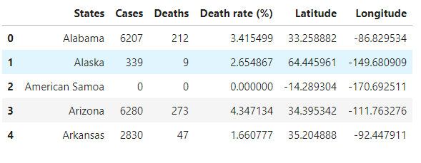
Data
Our data include States & number of patients (cases and deaths) collected from the link: https://en.wikipedia.org/wiki/2020_coronavirus_pandemic_in_the_United_States
We also collect data on hospitals' locations from Foursquare API and geojon file data of US states.
Notes:
Comfort
Durability; wear, stress

Slide 5
Methods
Data is transferred to a data frame first to deal with data efficiently.
Then data was modified based on the goal of this project.
The death rate (deaths/cases) is used to rank the risk of each state.
Visualized map of death rate is build to help understand the overall situation and identify the high-risk state.
On the search of hospitals, the hospitals' location will be extracted from Foursquare API based on the patients’ location,
Then visualized by the map so that the patients have the choices to reach the nearest hospitals.
Notes:
Comfort
Durability; wear, stress

Slide 6
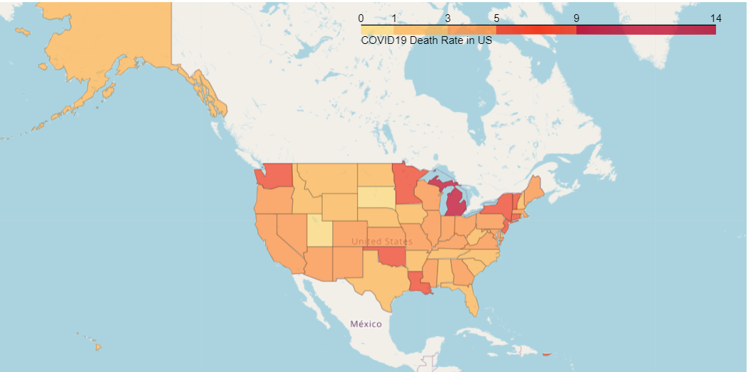
Results and Discussion
According to the death rate (deaths/cases) at each state, we divided states into 5 groups:
low risk: death rate < 1%
medium risk: 1% <= death rate < 3%
high risk: 3% <= death rate < 5%
very high risk: 5% <= death rate < 9%
extreme high risk: death rate >= 9%
Notes:
1

Slide 7
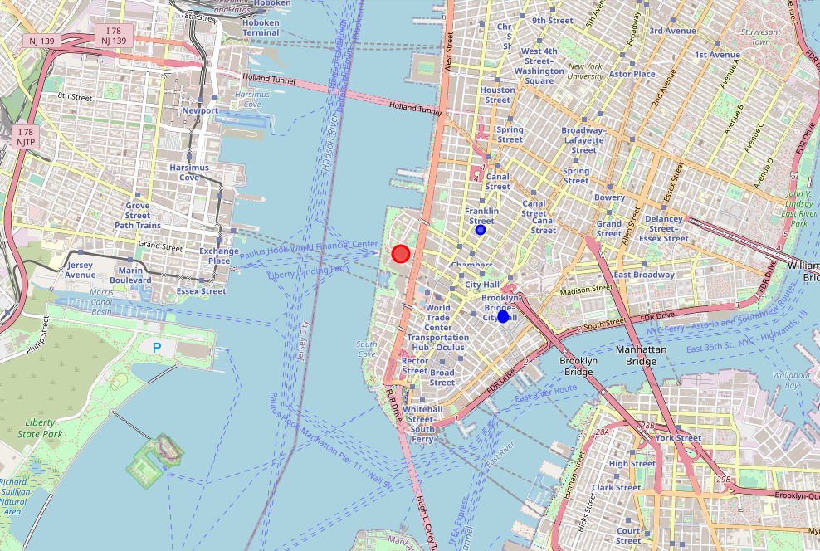
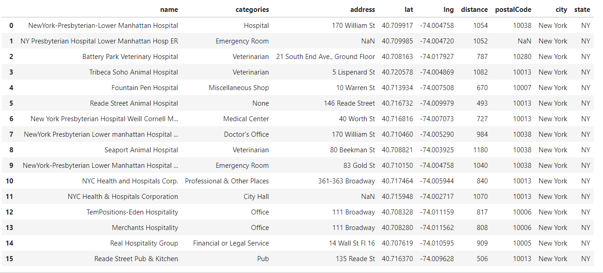
Results and Discussion
from the patient’s location, we can extract the hospitals’ locations nearby, then the patient can choose the nearest one to visit.
Notes:
1

Slide 8
Conclusion
The analysis above will help the government understand the situation for making a proper supported plan over limited resources. For example, those states having high-risk status get prioritized in the distribution of medical supply (masks, medicine, protection kit...), workforce (specialist, nurses, doctors...), food,...
And the patients can reach the nearest hospitals to have healthcare check-up as soon as possible before spreading the diseases.
Notes:
1

Slide 9
The Battle of the Neighborhoods
Coursera
Minh Cong Tran
April 27th, 2020

